Slide 1
California State University, Sacramento
Computer Science Department
CSc 131
Computer Software Engineering
Fall 2021
Lecture # 6
Object Oriented Design
UML Interaction Diagrams
(Sequence, Collaboration and State Chart Diagrams)

Slide 2
Interaction Diagrams
UML Specifies a number of interaction diagrams to model dynamic aspects of the system
Dynamic aspects of the system
Messages moving among objects/classes
Flow of control among objects
Sequences of events

Slide 3
Dynamic Diagram Types
Interaction Diagrams - Set of objects or roles and the messages that can be passed among them.
Sequence Diagrams - emphasize time ordering
State-chart Diagrams
State machine consisting of states, transitions, events and activities of an object
Activity Diagrams
Emphasize and show flow of control among objects

Slide 4
Sequence Diagrams
Describe the flow of messages, events, actions between objects
Show concurrent processes and activations
Show time sequences that are not easily depicted in other diagrams
Typically used during design to document and understand the logical flow of the system
[Continued…]

Slide 5
Sequence Diagram Basics
Object 1
Object 2
Object 3
message()
Message
Self-Call
Activation Box
Return
Lifeline
Deletion
X
[Continued…]

Slide 6
Sequence Diagram Rules
Options ,loops, and alt/else
These constructs complicate a diagram and make them hard to read/interpret.
Often it is better to create multiple simple diagrams
Create sequence diagrams for use cases when it helps clarify and visualize a complex flow
Remember: the goal of UML is communication and understanding
[Continued…]

Slide 7
Sequence Diagram
A sequence diagram provides a detailed view of a use case.
It shows an interaction arranged in a sequence over time.
It helps document the flow within the application.
In a comprehensive software system, the sequence diagram can be quite detailed, and can include thousands of messages.
[Continued…]

Slide 8
Elements of the Sequence Diagram
Objects appear along the top margin
Each object has a life line , a dashed line that represents the life of the object
A focus of control- is a tall, thin rectangle that sits on top of an object’s lifeline
Messages that show the actions that objects perform on each other and on themselves.
[Continued…]

Slide 9
Security System Example
Homeowner
Control Panel
System
system ready
enters passcode
initiates beep
beep sounded
ready for activation
selects stay/away
(de)/activate sensors
sensors (de)/activated
request light on
light on
ready for next action
[Continued…]

Slide 10
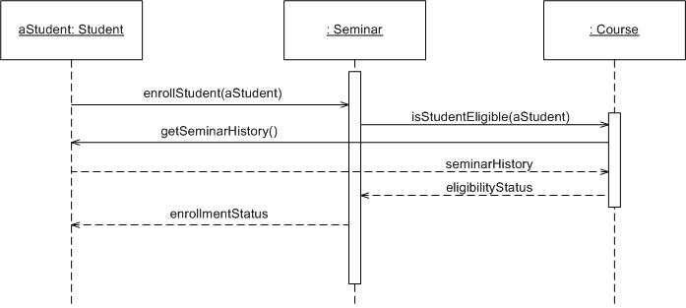
Sequence Diagram –Another Example
[Continued…]

Slide 11
Benefits of using UML Sequence Diagrams
Allow the software engineer to flush out details before implementation.
Useful tools to find architectural, interface and logic problems early in the design process.
[Continued…]

Slide 12
Allows software engineer to validate architecture, interfaces, and logic by exploring how the system architecture would handle different basic scenarios and special cases.
It forces the software engineer to think about details such as interfaces, states, message order, assignment of responsibilities, and special/error cases ahead of
[Continued…]

Slide 13
Benefits of using UML Sequence Diagrams
Valuable collaboration tools during design meetings because they allow software engineer to discuss the design in concrete terms.
To document the dynamic view of the system design at various levels of abstraction, which is often difficult to extract from static diagrams or even the complete source code.
Can abstract much of the implementation detail and provide a high level view of system behavior.

Slide 14
Collaboration Diagrams
UML collaboration diagram is a diagram, that focus on the organization of the objects that participate in a given set of messages.
They show objects and messages, but no lifelines or focus of control rectangles.
[Continued…]

Slide 15
Collaboration Diagrams
A collaboration diagram is another type of interaction diagram.
Like a sequence diagram, it shows how a group of objects in a use case work with one another.
Each message is numbered to document the order in which it occurs.
[Continued…]

Slide 16
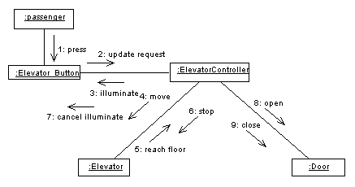
Collaboration Diagrams

Slide 17
State Chart Diagrams
Very similar to those in Structured Analysis
Describe the lifecycle of an object
All the possible states of an object
How the object’s state changes as a result of events that reach the object
Good at describing the behaviour of an object across several use cases
Use state diagrams only for classes that exhibit interesting behaviour
[Continued…]

Slide 18
State Chart Diagram
Shows the following:
The life history of a given class
The events that cause a transition from on state to another
The actions that result from a state change
State charts are created for objects with significant dynamic behavior
[Continued…]

Slide 19
State Chart Diagram Example
Add student[ count < 10 ]
Add Student /
Initialization
Set count = 0
Open
Cancel
Cancel
[ count = 10 ]
Canceled
Cancel
Closed

Slide 20
Summary
Use collaboration and sequence diagrams to:
Capture the behaviour of a single use case.
Show collaborations among objects.
Use state chart diagrams to:
Describe the behaviour of an object across several use cases.
Model classes that exhibit interesting behaviour.

Slide 21
USE CASE Driven…
A use case leads to a sequence diagram.
The sequence diagram is used to allocate behavior among objects mentioned in the use case.
This behavior becomes methods
These methods becomes operations on the classes

Slide 22
What is Next
More On UML Class and Sequence Diagrams
Continue on the SDD & Implementation

Slide 23
Questions?

